Slide 1



Noida Institute of Engineering and Technology, Greater Noida
Additive Manufacturing (3D Printing)
Unit:3
Digital Manufacturing Practices
(AME-0151/0251)
Assistant Professor
Department of Mechanical Engg.
Course Details: (B Tech 1st /2nd Sem)

Slide 2
Course Objective
Upon completion of this course, the students will gain knowledge of the different basic manufacturing processes and recent trends in modern manufacturing sector, which are commonly employed in the industry, to produce/fabricate components using different materials.
Students will understand the transformation that is happening through digital manufacturing and design (DM&D) – a shift from paper-based processes to digital processes in the manufacturing industry.

Slide 3
Course Outcome
Once the student has successfully completed this course, he/she will be
able to:
CO1
CO2
CO3
CO4
Understand various manufacturing process which are applied in the industry
Demonstrate the construction and working of conventional machine tools and computer controlled machine tools.
Understand the programming techniques of CNC machines and Robotic arms.
Use the different 3D printing techniques.

Slide 4
CO-PO Mapping
 | PO1 | PO2 | PO3 | PO4 | PO5 | PO6 | PO7 | PO8 | PO9 | PO10 | PO11 | PO12
CO1 | 3 | 1 | 1 | 2 | 2 | 2 | 1 | 1 | 3 | 2 | 1 | 2
CO2 | 3 | 1 | 1 | 1 | 1 | 2 | 1 | 1 | 2 | 1 | 1 | 3
CO3 | 3 | 1 | 1 | 1 | 2 | 2 | 1 | 1 | 2 | 1 | 1 | 2
CO4 | 3 | 1 | 1 | 2 | 1 | 2 | 1 | 1 | 2 | 1 | 1 | 2

Slide 5
Unit Objective and Topic Objective
Topic
Additive Manufacturing
Unit
Objective
After completion of the topic, student will be able to understand-:
Topic
Objective
After completion of the unit, student will be able to understand-:
Basic concept of additive manufacturing technologies
Injection moulding technique
How to produce prototype for analysis/study using 3D printing
How to write programme for making 3D CAD model using

Slide 6
Prerequisite and Recap (AM)
Prerequisite
Recap
3D printing software: Autodesk Fusion 360, Autodesk AutoCAD, TinkerCAD, MeshLab, FreeCAD, Creo, Solidworks etc.
Mechanical aptitude, ability to read blue prints and drawings.
Awareness about modern manufacturing technogy
Different manufacturing processes and machining operations

Slide 7
Contents
Introduction to Additive Manufacturing
CNC machining Vs Additive Manufacturing
AM process chain
Classification of AM process
Fused Deposition Modelling (FDM)
Stereolithography (SLA)
3D Scanning
Advantages and Disadvantages of AM
Application of AM
Reverse Engineering
Introduction to Injection moulding
Video links for AM and Injection moulding
Daily Quiz
Weekly assignment
MCQs
Expected Questions for University Exam
Summary
References

Slide 8
Introduction to AM (CO4)
The term Additive Manufacturing (AM) describes a process for rapidly creating an object or part representation before commercial production.
The term AM encompasses many technologies including subsets like 3D Printing, Rapid Prototyping (RP), Direct Digital Manufacturing (DDM), layered manufacturing and additive fabrication
The basic principle of this technology is that a model, initially generated using a 3D CAD model, can be fabricated without need for process planning.
It is fundamentally additive rather than subtractive in nature.
AM is versatile, flexible, highly customizable and, as such, can suite most sectors of industrial production

Slide 9
AM Definition (CO4)
Additive Manufacturing (AM) refers to a process by which digital 3D design data is used to build up a component in layers by depositing material.
The 3D printing process builds a three-dimensional object from a computer-aided design (CAD) model, usually by successively adding material layer by layer, this is why it is also called additive manufacturing.
The term AM encompasses many technologies including subsets like 3D Printing, Rapid Prototyping (RP), Direct Digital Manufacturing (DDM), layered manufacturing and additive fabrication.

Slide 10
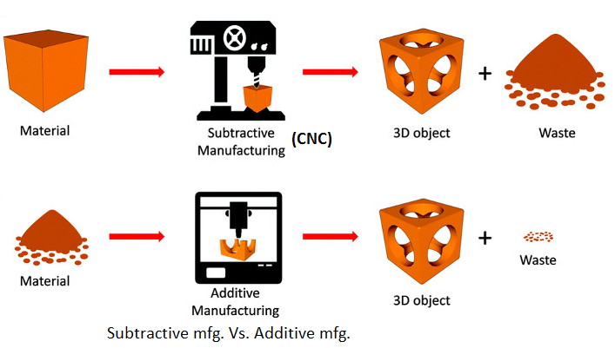
CNC machining Vs Additive manufacturing ( CO2)

Slide 11
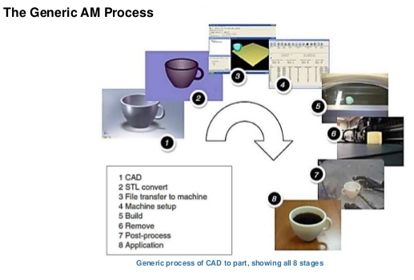
AM process chain (CO3)

Slide 12
AM process chain. Contd…
Conceptualization and CAD model:
AM process starts with CAD information
Model detail is generated by computer using various CAD software
Conversion to STL (Stereo Litho Graphy):
STL-a way to describe a CAD model in terms of geometry alone
Approximate model surface with series of triangular facets
Min. size of triangle set within most CAD software
STL is automatic within CAD software
Transfer to AM machine and STL file manipulation
Created STL file sent directly to AM machine
Correctness of part is checked by visualization tool
Reposition and change in orientation may be done

Slide 13
AM process chain. Contd…
Machine setup:
AM machine have specific setup parameters depending upon process and materials
Build setup:
First few steps are semi-automatic that require considerable manual control, interaction and decision making.
After this switch to computer controlled building phase.
AM machines have similar sequence of layer control, using a height adjustable platform, material deposition, and layer cross section formation.
Process repetition until build is complete
Removal and cleaning:
Output from AM machine should be ready to use

Slide 14
AM process chain. Contd…
Post process:
Steps of finishing the parts as per application of part
May include abrasive finishing, polishing and sandpapering or coating.
Application:
After post processing, parts are ready to use.
Parts may not behave according to standard material specification.
Parts may have voids/bubble trapped, which could be source of part failure under mechanical stress

Slide 15
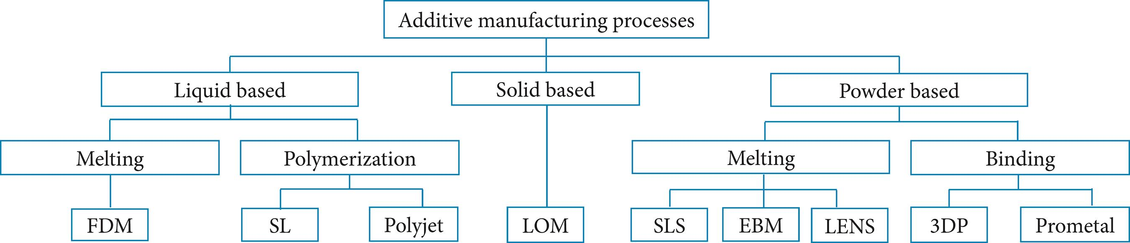
Classification of AM (CO4)

Slide 16
Points of difference among different AM processes
Techniques used for creating layers
Techniques of bonding the layers together
Speed
Layer thickness
Range of material
Accuracy
Cost

Slide 17
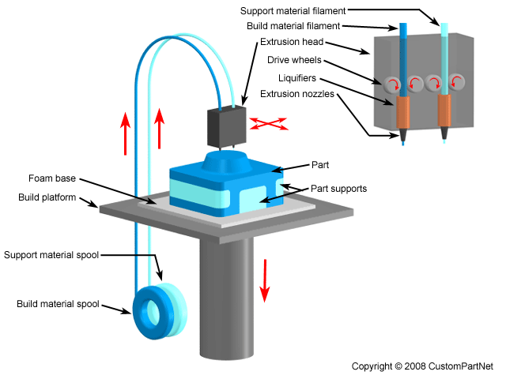
Fused Deposition Modelling (FDM) (CO4)

Slide 18
Fused Deposition Modelling (FDM)….
A spool of themoplastic wire (typically acrylonitrile butadiene styrene (ABS)) with a 0.012 in (300 μm) diameter is continuously supplied to a nozzle.
The nozzle heats up the wire and extrudes a hot, viscos strand (like squeezing toothpaste of of a tube).
A computer controls the nozzle movement along the x- and y-axes, and each cross-section of the prototype is produced by melting the plastic wire that solidifies on cooling.
In the newest models, a second nozzle carries a support wax that can easily be removed afterward, allowing construction of more complex parts. The most common support material is marketed by Stratasys under the name WaterWorks.
The sacrificial support material (if available) is dissolved in a heated sodium hydroxide (NaOH) solution with the assistance of ultrasonic agitation.

Slide 19
Fused Deposition Modelling (FDM)….
Advantage(s):
• Economical (inexpensive materials)
• Enables multiple colors
• Easy to build DIY kits (one of the most common technologies for home 3D printing)
• A wide range of materials possible by loading the polymer
Disadvantage(s):
Materials suite currently limited to thermoplastics
Key Application:
Conceptual Models
• Engineering Models
• Functional Testing Prototypes

Slide 20
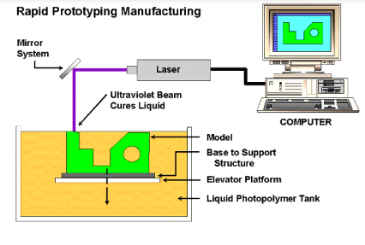
Stereolithography (SLA) (CO4)

Slide 21
Stereolithography (SLA)…..
Stereolithography: is a form of 3D printing technology used for creating models, prototypes, patterns, and production parts in a layer by layer fashion using photochemical processes by which light causes chemical monomers and oligomers to cross-link together to form polymers.
A structure support base is positioned on an elevator structure and immersed in a tank of liquid photosensitive monomer, with only a thin liquid film above it.
A UV laser locally cross-links the monomer on the thin liquid film above the structure support base.
The elevator plate is lowered by a small prescribed step, exposing a fresh layer of liquid monomer, and the process is repeated
At the end of the job, the whole part is cured once more after excess resin and support structures are removed

Slide 22
Stereolithography (SLA)….
Advantages:
• Fast
• Good resolution
• No need for support material
•Photosensitive polymers have
acceptable mechanical properties
Disadvantages:
Expensive
• Expensive materials (photosensitive resins are ~$100-200 /kg)
• Material suite limited to resins
Key Application:
Patterns for metal processing (e.g., molding)
• Prototypes for demonstrational purposes

Slide 23
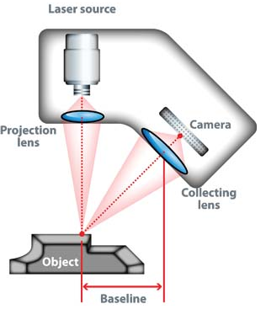
3D Scanning (CO4)
3D Scanning is a non-contact, non-destructive technology that digitally captures the shape of physical objects using a line of laser light.
A way to capture a physical object's exact size and shape into the computer world as a digital 3-dimensional representation.
Digital replica using electronic instrument for creating high-precision 3D models of real-world objects.

Slide 24
Working principle of 3D Scanner
A laser scanner is mounted on a tripod next to the area to be scanned.
The scanner fires a laser and measures the time it takes for the laser to be reflected back, with which it can calculate the distance from the reflected point.
The scanner systematically sweeps the room with these measurements until it has a complete picture of the 3D space round it.
This collection of measurements is called a point cloud, and is the data set from which we can extract valuable information and 3D models.

Slide 25
3D Scanner….
Advantages:
• Applicable to all 2D and 3D surfaces
• Rapid 3D data collection
• Ideal for all 3D modelling and visualization purposes
•Rapidly developing survey technology
Disadvantages:
• Some system do not work in sun or rain
• Large 3D data sets require post-processing to produce a useable output
• Output requires manipulation to achieve acceptable reading quality
• Hardware expensive and sophisticated software required to process data
Key Application:
Automotive, Architecture, Medical, Quality control, Reverse engineering, Video gaming and animation, Physical prototype

Slide 26
Advantages of AM
Direct translation of design to component
Generation of parts with greater customization with no additional tooling or manufacturing cost
Functional design allowing manufacturing of complex internal features
Flexible and lightweight component manufacturing with hollow or lattice structures
Ability of direct manufacturing of components to their final or near net shape with minimal or no additional processing
Potential to approach zero waste manufacturing by maximizing material utilization
A great reduction in overall product development and manufacturing time leading to quicker transfer to market
Excellent scalability.

Slide 27
Disadvantage of AM
Limited material selection
Differences in material properties
High Initial Investment and Required Maintenance Expertise
High process cost
Low speed, not suitable for mass production
Un-expected pre-and post-process requirement
Lack of Industry standards

Slide 28
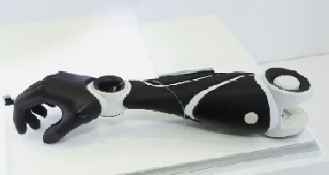
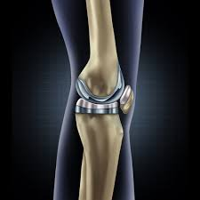
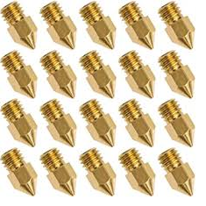
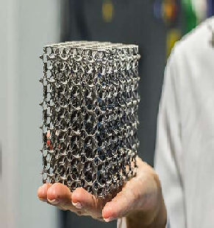
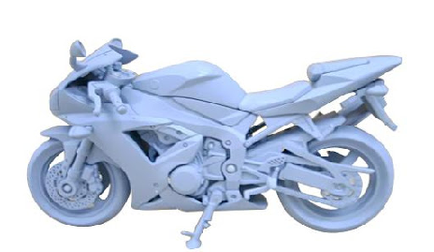
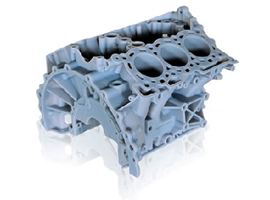
Application of AM

Slide 29
Application. Contd…
Agile tooling
Research and Development
Medical application
Pharmaceutical Formulations
Bio prints
Industrial art and jewelry
Apparel
Automotive industry
Construction
Computers and robots
Domestic use and space

Slide 30
Pre-requisitive, Recap &Topic Objective:RE
Topic
Reverse Engineering
Pre-requisite
Knowledge of design software
Computer aided design
Recap
Engineering drawing
Computer graphics and modelling
Topic objective
Redesign and modification of existing design
Reconstruction of old components with advance feature

Slide 31
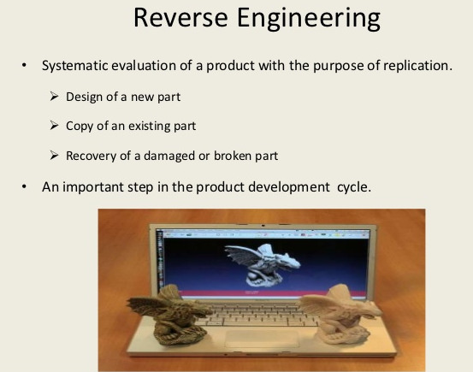
Reverse Engineering: Introduction (CO4)

Slide 32
Reverse Engineering:Introduction……
Engineering: Forward and Reverse Engineering
Forward engineering is the traditional process of moving from high-level abstractions and logical designs to the physical implementation of a system.
In some situations, there may be a physical part/ product without any technical details, such as drawings, bills-of-material, or without engineering data.
The process of duplicating an existing part, sub-assembly, or product, without drawings, documentation, or a computer model is known as reverse engineering.

Slide 33
Reverse Engineering:Introduction…..
The process of digitally capturing the physical entities of a component, referred to as reverse engineering (RE).
In mechanical engineering, RE is an integrated domain that helps us to bring out technological and physical principals of any mechanical part or component by undergoing the analysis procedure of some of its basic aspects such as structure, function and operation.
Reverse engineering is the process of discovering the technological principles of a device, object, or system through analysis of its structure, function, and operation.

Slide 34
Why Reverse Engineering?
The original manufacturer no longer exists, but a customer needs the product, e.g., aircraft spares required typically after an aircraft has been in service for several years.
• The original manufacturer of a product no longer produces the product, e.g., the original product has become obsolete.
• The original product design documentation has been lost.
• Creating data to refurbish or manufacture a part for which there are no CAD data, or for which the data have become obsolete or lost.
• Some bad features of a product need to be eliminated e.g., excessive wear might indicate where a product should be improved.

Slide 35
Why RE?......
• Strengthening good features of a product based on long-term usage.
Analyzing the good and bad features of competitors’ products.
Exploring new avenues to improve product performance and features.
• Creating 3-D data from a model or sculpture for animation in games and movies.
• Creating 3-D data from an individual, model or sculpture to create, scale, or reproduce artwork.
• Architectural and construction documentation and measurement.

Slide 36
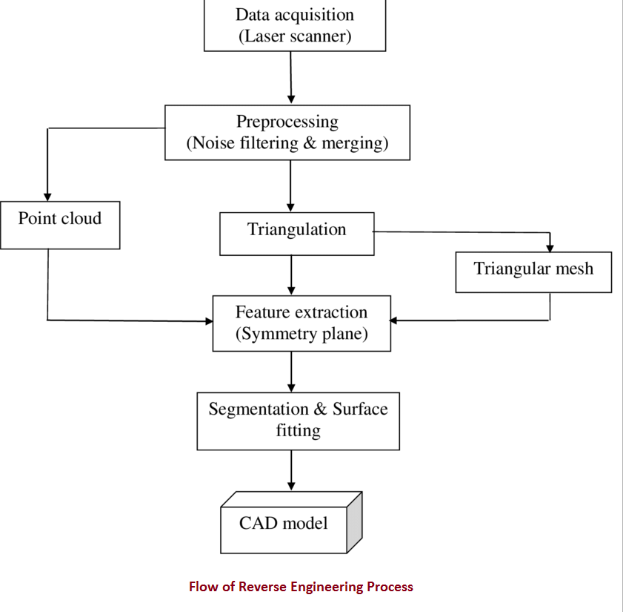
Flow of Reverse Engineering

Slide 37
Pre-requisitive, Recap &Topic Objective
Topic
Injection Moulding
Pre-requisite
Knowledge of plastic materials
Recap
Basics of manufacturing process (Unit-1)
Topic objective
To understand working principle of injection moulding machine
To make familiar with commercial plastic processing technique

Slide 38
Injection Moulding Process-Introduction (CO1)
The injection machine is a machine that melt plasticize the molding material inside the heating cylinder and inject this into the mold tool to create the molded product by solidifying inside it.
The injection machine is constructed of a mold clamping device that opens and closes the mold tool, and device that plasticize and inject the molding material.
There are several types in the injection machine, and the difference is made by how these two devices are arranged.

Slide 39
Injection Moulding : Classification
（1） Horizontal injection machine ： Both mold clamping device and injection device compounded horizontally
（2） Vertical injection machine ： Both mold clamping device and injection device compounded vertically
（3） Two-color injection machine
（4） Rotary injection machine
（5） Low foam injection machine
（6） Multi material injection machine
（7） Sandwich injection machine .

Slide 40
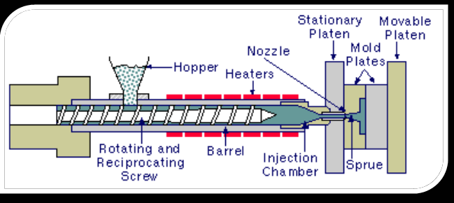
Injection Moulding Process-Components

Slide 41
Youtube & NPTEL Video Links and Online Courses Details
https://youtu.be/gcia0aqZMf0?t=17
https://www.metal-am.com/introduction-to-metal-additive-manufacturing-and-3d-printing/
https://youtu.be/sPhTjrvpGyE
https://youtu.be/NkC8TNts4B4?t=169
https://youtu.be/W2QpGdsTIJ8
https://youtu.be/sCIZMybynec

Slide 42
Daily Quiz (AM)
Why can additive manufacturing create parts that no other technique can make?
Is there material limitation in additive manufacturing?
Name some products , produced by 3D printing, which are being used my medical professional.
Why programme is feed in 3D printer?
Suggest some software, used in additive manufacturing.
Which types of 3D printing technologies are there?
Which mechanism is used in additive manufacturing for part programming?
Whether cutting tool is used in 3D printing or not. Comment.
Name some products re-designed/re-manufactured using RE.

Slide 43
Daily Quiz(AM)….
Name major parts of FDM machine.
Is there material limitation in FDM technique?
Name some products , produced by FDM, which are being used in industry.
Why reverse engineering is required to be explored?
Suggest some products, that can be produced by SLA Technique.
Which component(s) is made using Injection moulding?
Name some 3D scanning machine.
Which is the best procedure for fast 3D scanning?
What is a point cloud?

Slide 44
Weekly Assignment (AM)
What is 3D printing?
What software do I need for 3D printing?
What are the most common 3D printing file formats?
How to start if we want to design a 3D print model?
How can I modify an existing 3D printing model?
How to 3D print text or nameplates?
What are the differences between 3D printing and 3D scanning?
What are the benefits of 3d printing compared to injection molding?
Why do we use reverse engineering?

Slide 45
Weekly Assignment (AM)….
What does 3D Laser Scanning Work?
Can you scan large areas or multiple levels of a building?
What is 3D Laser scanning?
Reverse engineering vs Re-engineering. Comment?
What is objective of reverse engineering?
Which liquid is used in stereolithography?
What are the limitations of stereolithography?
How many types of injection moulding are there?
What do you mean by plastic moulding?

Slide 46
MCQs (AM)
1. In keyhole mode of laser welding, hole is stabilized by the _____ a) weld puddle b) shielding gases c) pressure of the vapour d) laser beam
2. Which of the following is NOT a 3-D printing approach?
a) CNC b) Photo polymerization c) FDM
3. Which of the following fields or industries have used 3-D printing?
a) Art b) Medical c) Electronics industry d) All
4. What was the name of the first commercially successful 3-D printer using the ink
jet approach for rapid prototyping (RP)?
a) V-flash personal 3-D printer b) Model maker c) Stereolithograph apparatus
Which of the following materials have been used to create objects with 3-D printers?
a) Plastics b) Ceramic c) Both d) None

Slide 47
Expected Questions for University Exam
Note: No End semester theory exam for this subject, only practical subject
As 3D printing improves, how will it change traditional manufacturing processes?
Explain additive manufacturing with sequence of processes.
Why it is called additive manufacturing? What are various application areas?
What are various challenges of AM.
State various steps of RE.
Classify AM process. Explain Stereo lithography. How layer by layer adhesion takes place in stereo lithography?
Discuss recent contribution of AM in medical field. For what purpose 3D scanner is used?

Slide 48
Summary of AM
AM is a recent development in advanced manufacturing sector.
Material addition instead of removal in traditional secondary manufacturing processes
Cost effective in terms of material savings
Green manufacture in term of reduced wastages
Freedom of Design: Extremely Complex shapes feasible in fabrication
Flexibility with materials and properties
Digital process flow for Design to Manufacture
there is a significant interest in industry for taking up AM as one of the main production engineering route for the next generation.
AM has given rise to reverse engineering which has brought innovative design aspect of old components.

Slide 49
Summary of AM……
Reverse engineering enables the duplication of an existing part by capturing the component’s physical dimensions, features, and material properties.
RE brings less expensive & more efficient products to the market.
RE: Inspiring creative minds with old ideas.
Injection moulding process produces fast production, highly efficient and incredible amount of parts per hour.
Injection moulding has ability to use different types of plastic simultaneously with the help of co-injection molding.
It is possible to use fillers in the injection molds. These filler reduce the density of the and also help in adding greater strength to the part. In fields where parts need to be strong and durable, plastic injection has an option that other molding processes do not offer.

Slide 50
References
https://arrival3d.com/what-is-3d-scanning/
http://home.iitk.ac.in/~jrkumar/download/ME761A%20_Lecture%205%20Additive%20Manufacturing.pdf
https://www.caddman.com/3d-scanning/
https://nptel.ac.in/courses/112/107/112107221/
https://physicaldigital.com/what-is-reverse-engineering/#:~:text=In%20mechanical%20engineering%2C%20the%20term,which%20the%20item%20is%20constructed.

Slide 51

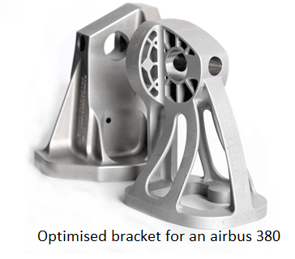
Noida Institute of Engineering and Technology, Greater Noida

